Slide 1
Capital Markets Regulatory Compliance Assistant
Team TRANSFORMERS
6th Feb 2026
TCS Confidential

Slide 2
AGENDA
A | Problem Statement
B | Solution Architecture
C | Technical Details
D | DEMO
E | Summary
F | Team Members

Slide 3
Problem Statement
Title Name:
Capital Markets Regulatory Compliance Checklist
Problem Statement:
Financial institutions face challenges in keeping up with constantly changing regulatory requirements, risking non-compliance and penalties
Data Requirements:
Regulatory documents, compliance manuals, financial policies, and updates from regulatory bodies.
Expected Output:
Summarized compliance checklists and alerts in structured text or spreadsheet format for easy tracking. Be creative to go beyond as you solve the above needs.

Slide 4
Our Understanding and Approach
Financial institutions in Singapore face an overwhelming regulatory landscape
17+
321
121
3
All constantly evolving
Acts
Local Govt Notices
Guidelines
Codes
Volume
MAS publishes 400+ regulatory instruments across Acts, Notices, Guidelines & codes
Velocity
Frequent updates on the Acts, guidelines, compliance documents etc.,
Complexity
Cross-referencing across SFA, FAA, FSMA, and subsidiary instruments is manual and error-prone
Cost of Failure
Penalties, license revocation, criminal prosecution, reputational damage, operational disruption
Current State
Compliance teams rely on manual document review, spreadsheets, and external legal counsel
Who it Affects
Compliance Officers & Legal Teams
Fund Managers & Capital Markets Intermediaries
Risk & Audit Departments
Board & Senior Management
Our Approach:
Build an AI-powered Regulatory Compliance Assistant that ingests Singapore's capital markets regulations, enables natural-language compliance queries, auto-generates compliance checklists, detects regulation changes, and delivers proactive alerts — all through an enterprise-grade interface.

Slide 5
Solution Architecture
UI interface
DashBoard
Documents Ingestion Service
RAG Query Engine
Checklist Engine
Settings
ChromaDB
LLM
Sqlite (metadata)

Slide 6
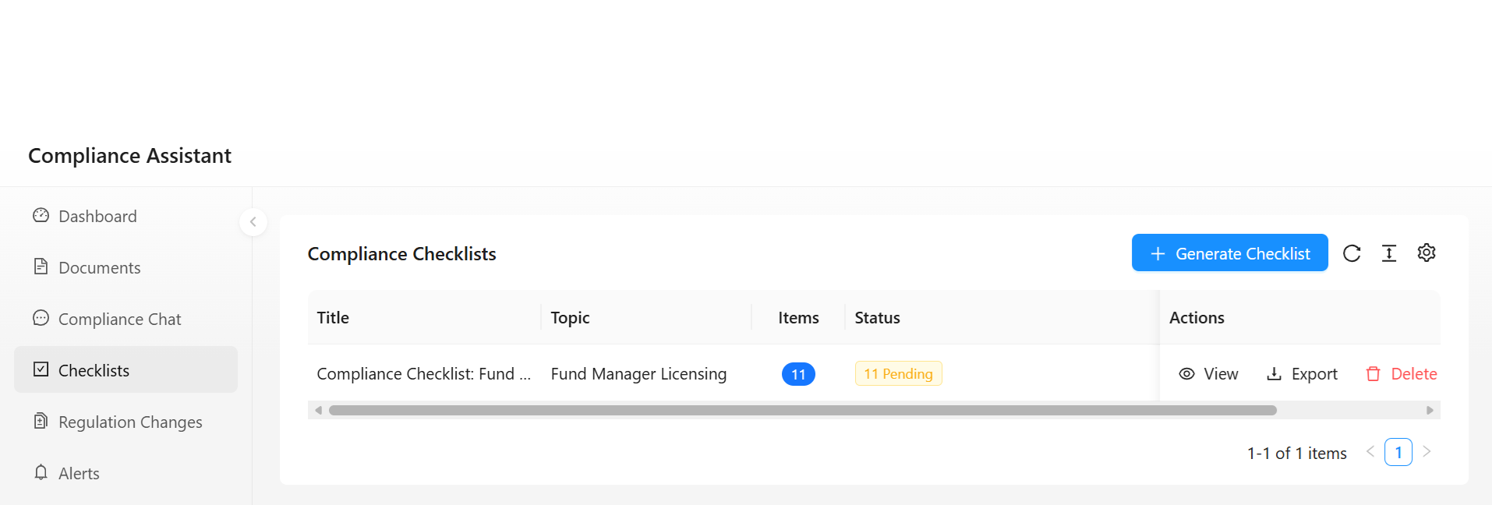
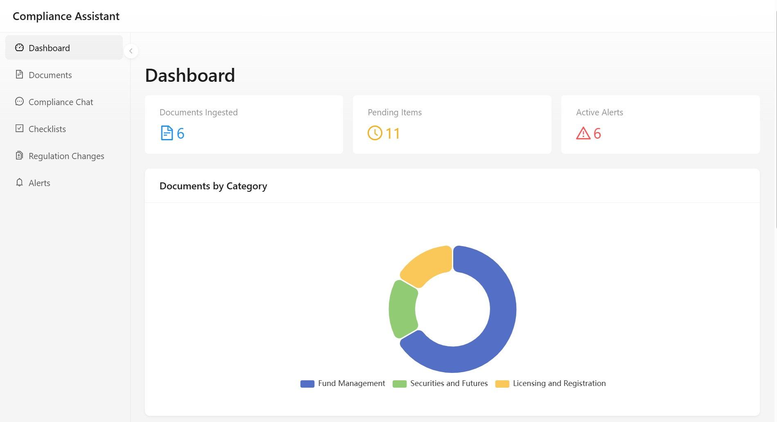
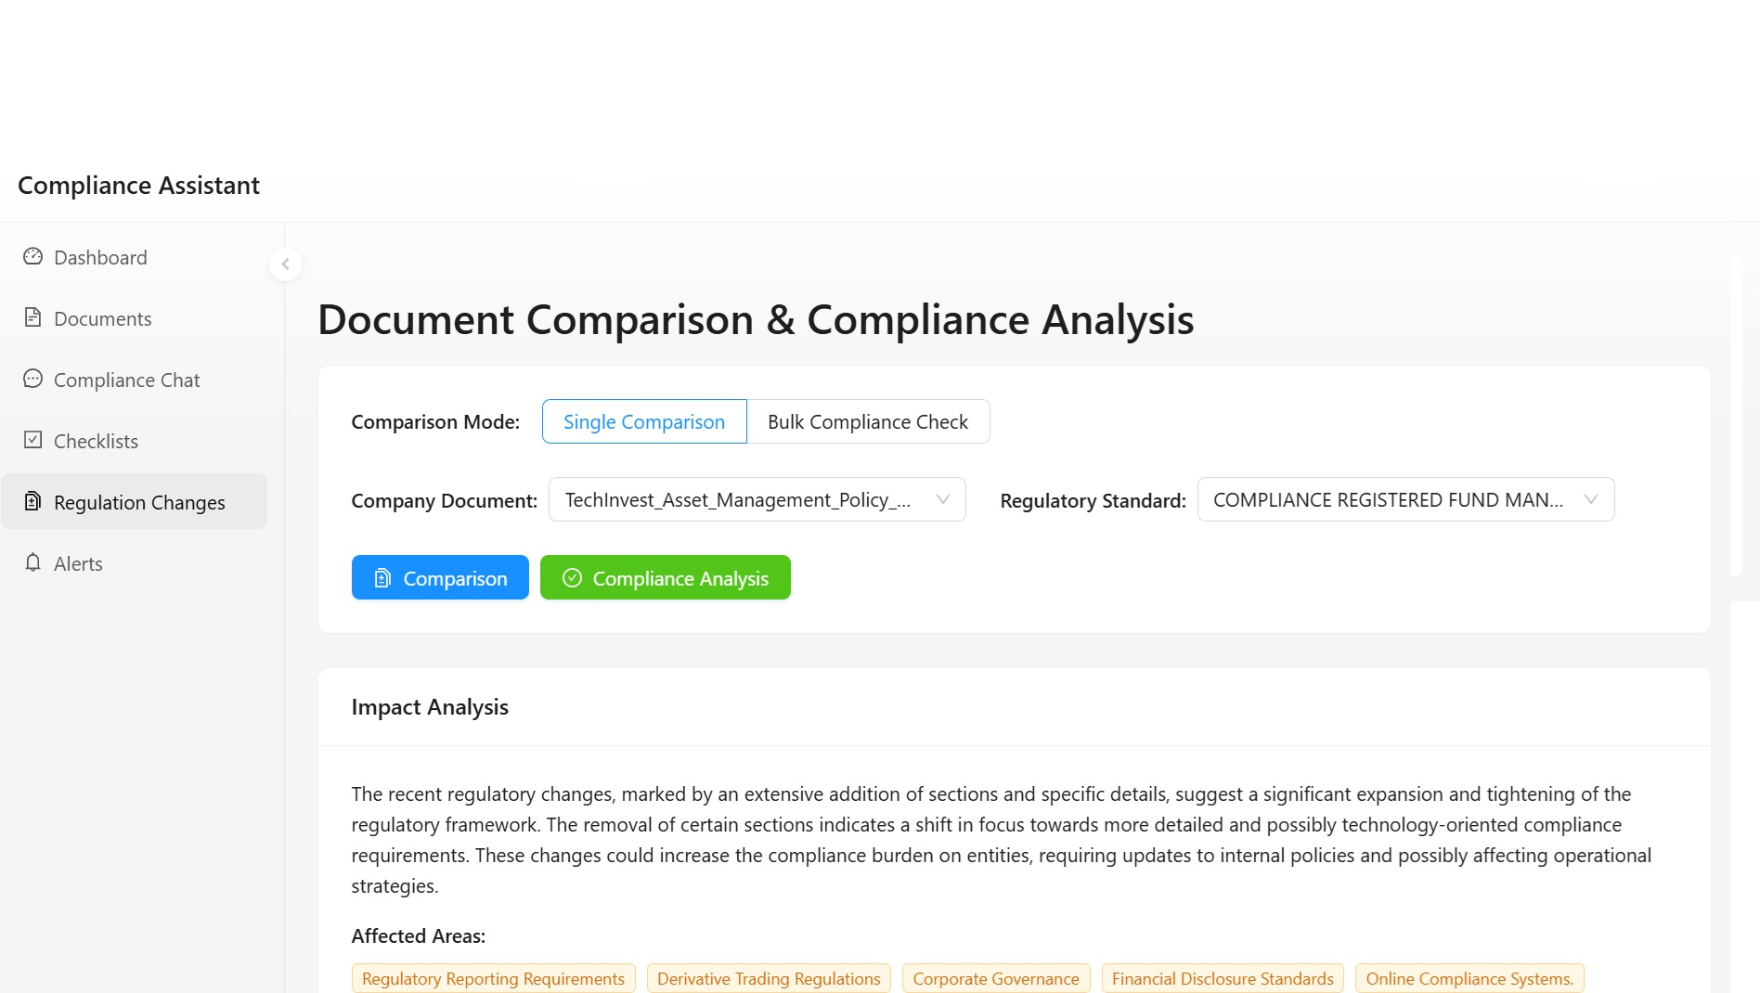
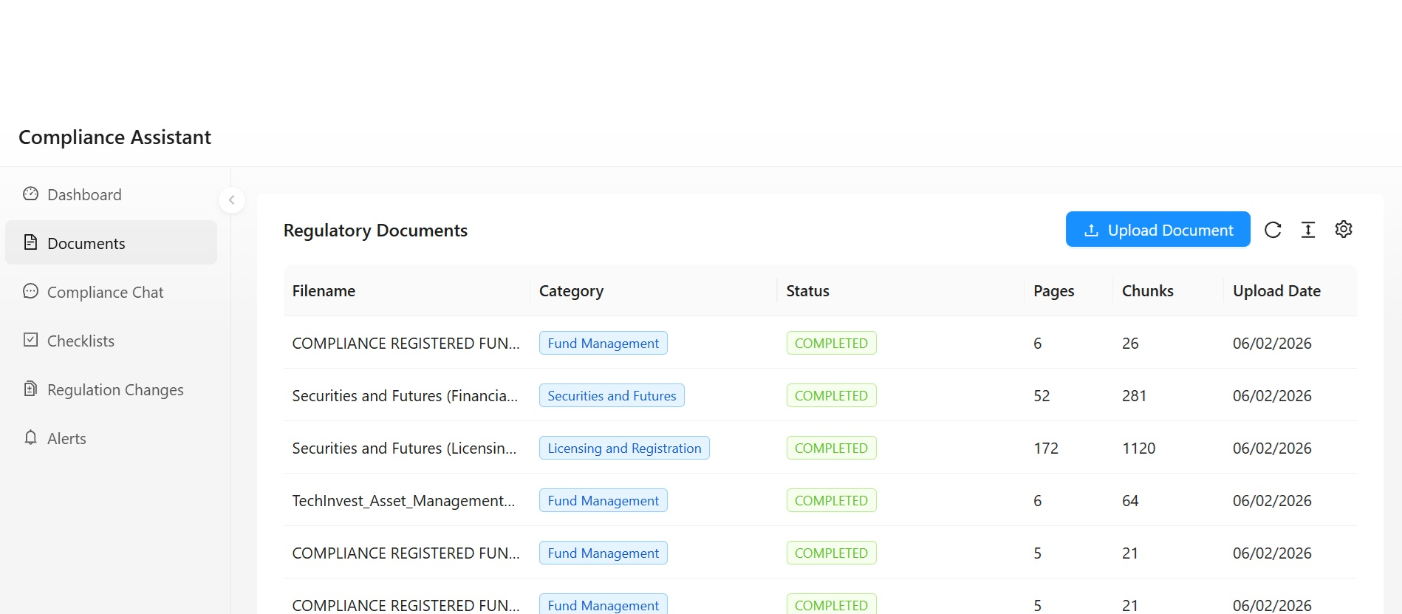
Compliance Assistant

Slide 7
High-Level Architecture
Frontend Layer
React JS + TypeScript + AntD+ Vite + TanStack Query
REST API + Server-Sent Events (SSE)
Backend Layer
FastAPI + Python + Async/Await Pattern Routers: Documents, Query, Checklists, Alerts, Settings
Services: Ingestion, Retrieval, Checklist, Diff, Export
Models: Database (SQLAlchemy) , Schemas (Pydantic)
SQLite (Async)
ChromaDB
(Vector)
OpenAI API
(LLM)
File Storage
(Uploads)

Slide 8
RAG ( Retrieval Augmented Generation) Pipeline
PDF Upload
Parse
Chunk
Embed
Store in ChromaDB
User Query
Embed query
Cosine similarity search
Assemble prompt with retrieved context
LLM generates cited answer

Slide 9
Key AI Concepts Used
RAG
Semantic Search
Recursive Text Chunking
Ground LLM responses in actual regulatory text and reduces hallucination
Vector similarity over 384-dim embeddings for relevant chunk retrieval
Smart splitting respecting sentence boundaries, ~400 chars to fit MiniLM's 256 word-piece limit
Auto-Classification
LLM classifies uploaded documents into regulatory categories (AML/CFT, Securities, Fund Mgmt, etc.)
Structured Output
LLM generates JSON-formatted compliance checklists from regulatory context
Change Detection
Cosine similarity comparison between document versions + LLM summarization of regulatory changes
Streaming Inference
Server-Sent Events for real-time, token-by-token chat responses

Slide 10
Innovation & Creativity
Specific Focus
Purpose-built for regulatory framework (SFA, FAA, FSMA, Notices, Guidelines, Codes)
Regulation Diff Engine
Upload new versions, auto-detect changes, get AI-summarized compliance impact
Risk Heatmap
Visual compliance risk scoring by regulation category × business unit
Model Agnostic
Swap LLM providers (OpenAI ↔ Claude ↔ Llama) without code changes
Enterprise Grade UI
Ant Design , Excel exports

Slide 11
Benefits
Intelligent Checklist Generation : Automatically create actionable compliance checklists with priority levels, deadlines, and regulation references
Automated Change Detection : Track regulatory updates with AI-powered version comparison that identifies additions, removals, and modifications with impact analysis
Proactive Alert Management : Stay ahead of compliance risks with automatic alerts for new regulations, classified by severity (critical/warning/info) and status tracking
Time Savings of 70-80% : Reduce compliance research time from hours to seconds through vector-based semantic search across all documents
Export-Ready Checklists : Generate professional Excel exports with formatting for seamless integration into existing compliance workflows
Compliance Score Dashboard : Monitor organizational compliance health at-a-glance with visual gauges, risk heatmaps, and activity timelines

Slide 12
Summary
Working end-to-end RAG compliance assistant for capital markets
Natural language regulatory queries with cited, grounded answers
Auto generated compliance checklists exportable as Excel
Regulation change detection with AI impact analysis
Proactive compliance alerts
Enterprise grade dashboard with risk visualization

Slide 13
Team Members (Transformers)
# | Emp Id | Name
1 | 246811 | Binesh U
2 | 758404 | Aasaithambi P
3 | 353445 | Simon Thambi S
4 | 2892597 | Chandrasekar Senthur Pandian
5 | 333272 | Arulnathan B

Slide 15
Technical Stacks - Front End
Component | Technology | Purpose
Framework | ReactJS | UI component library
Language | TypeScript | Type-safe development
UI Library | Ant Design Pro | Enterprise level UI Component
Build Tool | Vite | Fast dev server and bundler
State Management | TanStack Query | Server State Management
HTTP Client | Axios | API Communication
Markdown | ReactMarkdown | Render LLM Responses
SSE | Event Resource API | Streaming Responses

Slide 16
Technical Stacks - Back End
Component | Technology | Purpose
Framework | FastAPI | High-performance API framework
Language | Python | Core programming language and ML friendly
ASGI Server | Uvicorn | Async server
ORM | SQLAlchemy 2.0 (Async) | Database abstraction
Vector DB | ChromaDB | Document embeddings and search
Embeddings | all-MiniLM-L6-v2 | Sentence Transformers
LLM Client | OpenAI Python SDK | LLM API Integration
Streaming | sse-starlette | Server-Sent Events

